Slide 1
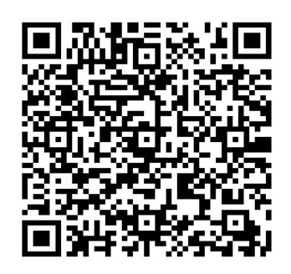
Mini Project-1 QR CODE GENERATOR
CHARAN RAJ 1602-20-737-009
GOURI MANASA 1602-20-737-014
SUHIDhAR 1602-20-737-048

Slide 2
Abstract:
A QR code is used to provide easy access to online information through the digital camera on a smartphone or tablet . Quick Response (QR) codes seem to appear everywhere these days. We can see them on posters, websites, product packaging, online payment and many other. Using the QR codes is one of the most interesting ways of digitally connecting people to the internet via mobile phones since the mobile phones have become a basic necessity thing of everyone.
In this project, we present a methodology and generate QR codes for student details, where the users need to enter their details like name, roll no. After entering the details ,QR code is generated ,we can scan and see the output.

Slide 3

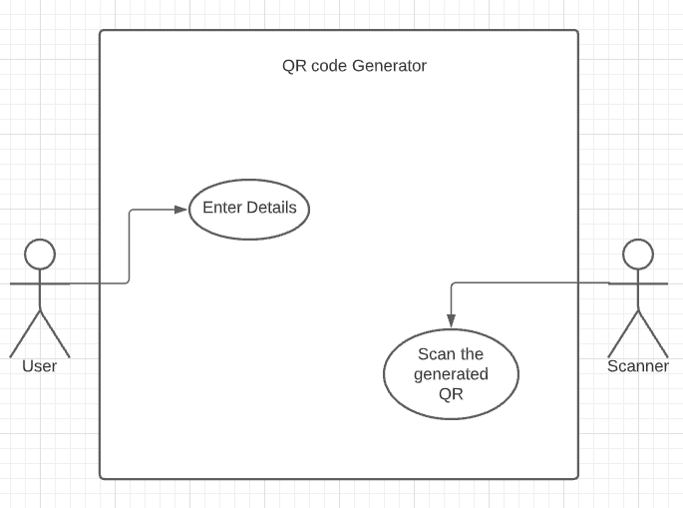
Use Case Diagram

Slide 4
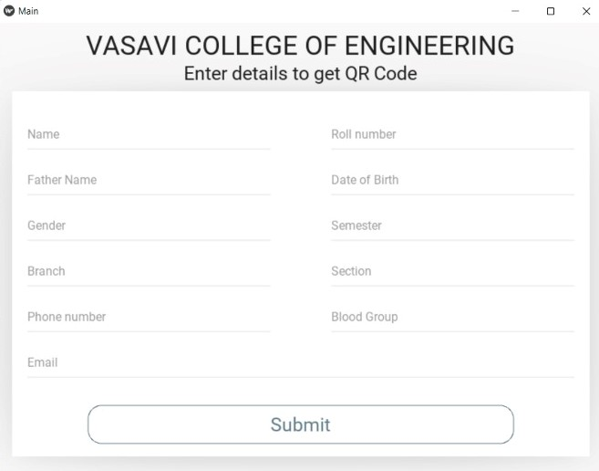
RESULT:
After running the code, a page is created with title “VASAVI COLLEGE OF ENGINEERING” ‘Enter details’.

Slide 5
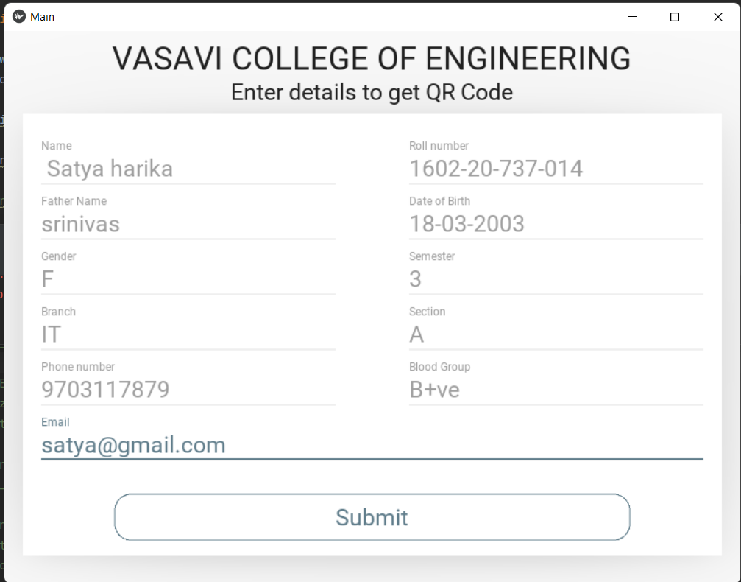
Enter the corresponding details and submit to generate QR.

Slide 6
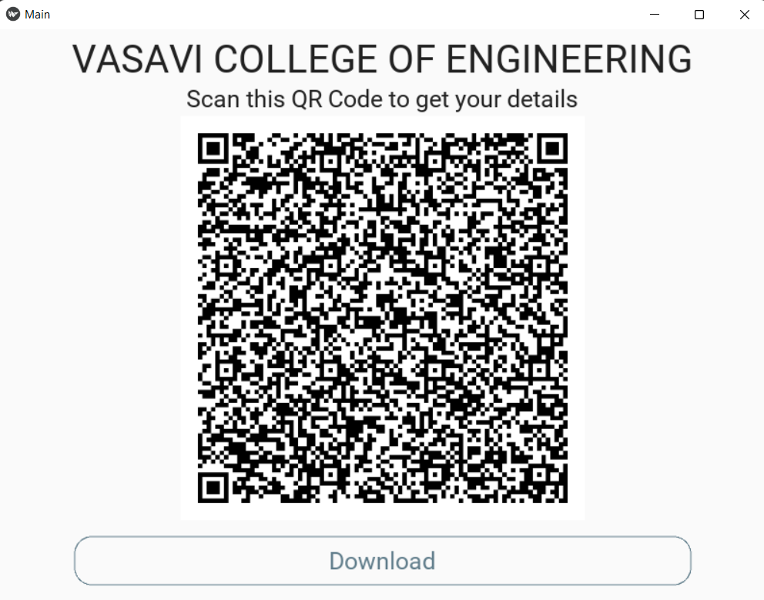
After submitting, QR code is generated, we can save it or we can scan to get the output.

Slide 7
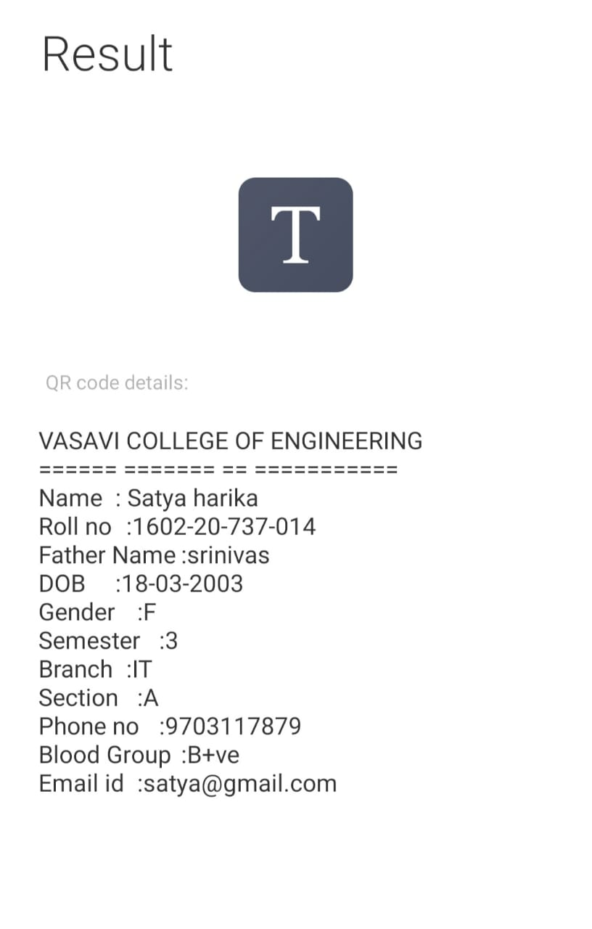
After scanning we will get the output.

Slide 8
Thank you

